Slide 1
Finding Objects and GRanularity

Slide 2
Analysis
Noun Analysis: write programme description, analyse nouns to find appropriate classes and verbs for appropriate behaviour
Analyse relationships and collaborations in your system and develop classes from these
Model the real world and translate the objects found during analysis into design

Slide 3
Problems
Software systems do not fully represent the realworld
Abstractions and concepts such as arrays do not exist or have no real representation in the real world
Software systems require additional abstractions to implement them such as abstract classes, interfaces which have no real world equivalent and may not show up in analysis.
Real world modelling represents current problems and solutions, does not necessarily lead to models and solutions appropriate for future application use.

Slide 4
Solutions
Adopt a flexible approach of real world modelling and noun analysis
Having developed basic system, look for system efficiencies that can be made
Look for system restrictions created by basic design
Analyse current problems and opportunities
Evaluate design patterns that might be appropriate for current system

Slide 5
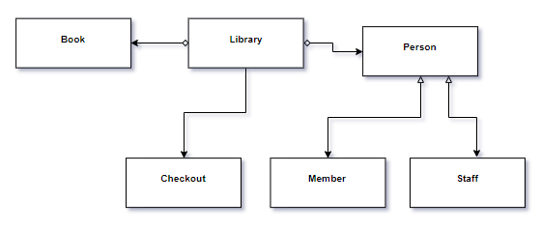
Library Example
Noun Analysis and Real World Modelling: Library, Book, Checkout, LibraryMember, LibraryStaff

Slide 6
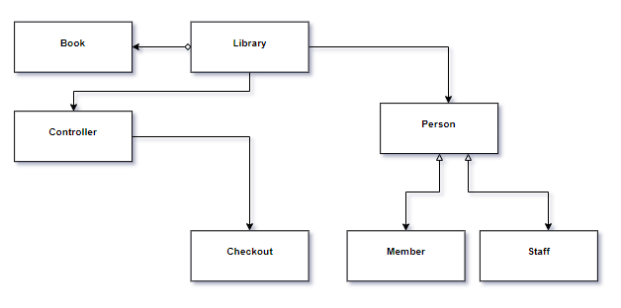
Library Example
Analyse current problems and opportunities
Evaluate design patterns that might be appropriate for current system

Slide 7
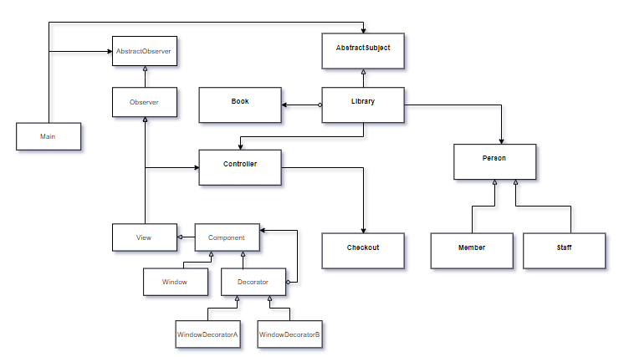
Library Example

Slide 8
Object Granularity

Slide 9
Granularity is a level of details. Granular objects are those, which are at low level detail in your program. Consider:
trees in game landscape
characters in document
seats in cinema
Usually you have many granular objects in application. If you will create separate object for each tree/character it could be very memory-consuming.

Slide 10
When we divide system into objects we must decide how data and behavior are divided among objects. The level at which this division occurs is called granularity and there is a direct relationship between higher granularity and the total number of objects in a system.
Achieving the correct amount of granularity in an object-oriented design is a balancing act. At the extreme of having too much granularity the system is comprised of many small objects this type of software projects becomes quite complex to develop and rather difficult to maintain.
Too Much Granularity :
Many small objects
Project becomes overly complex
Software performance decreases
Maintenance difficult
Too little granularity :
Several huge objects
Possible more prone to bugs
Maintenance difficult

Slide 11
Design pattern Helps to DO THIS BALNCE ACT
Facade pattern describes how to represent complete subsystems as objects.
Flyweight pattern describes how to support huge numbers of objects at the finest granularities.
Abstract Factory and Builder yield objects whose only responsibilities are creating other objects.
Visitor and Command yield objects whose only responsibilities are to implement a request on another object or group of objects.

Slide 12
The granularity of data refers to the fineness with which data fields are sub-divided. For example, a postal address can be recorded, with low granularity, as a single field:
address = 200 2nd Ave. South #358, St. Petersburg, FL 33701-4313 USA
or with high granularity, as multiple fields:
street address = 200 2nd Ave. South #358
city = St. Petersburg
postal code = FL 33701-4313
country = USA
or even higher granularity:
street number = 200
street = 2nd Ave. South #358
city = St. Petersburg
postal code state = FL
postal-code-first-part = 33701
postal-code-second-part = 4313
country = USA

Slide 13
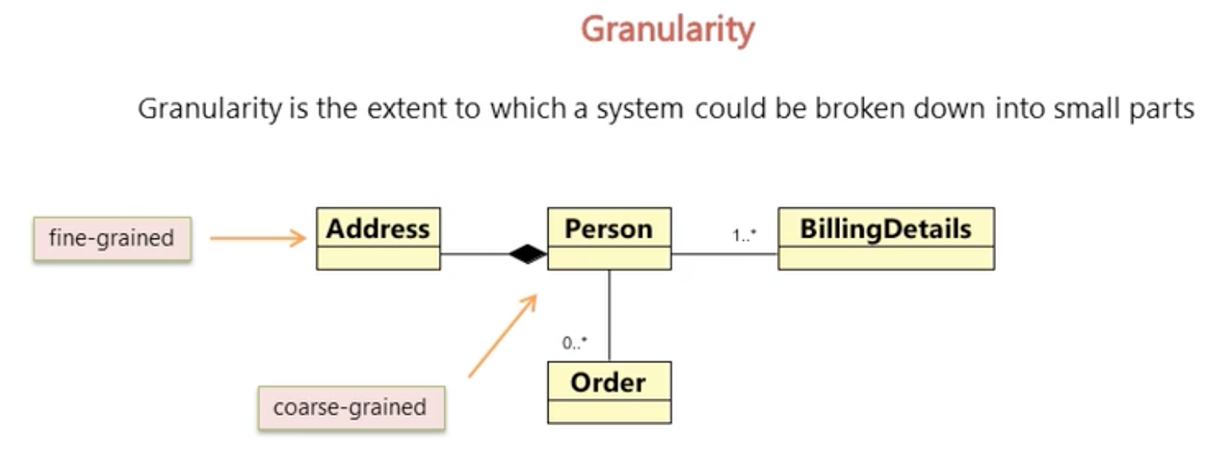

Slide 14
